Slide 1
Lecture 2
Fundamental Concepts of Computer Networks

Slide 2
1-1 DATA COMMUNICATIONS
The term telecommunication means communication at a distance. The word data refers to information presented in whatever form is agreed upon by the parties creating and using the data.
Data communications are the exchange of data between two devices via some form of transmission medium such as a wire cable or wireless.
Delivery → Correct destination
Accuracy → Accurate data
Timelines → Real-time transmission
Jitter → Uneven delay

Slide 3
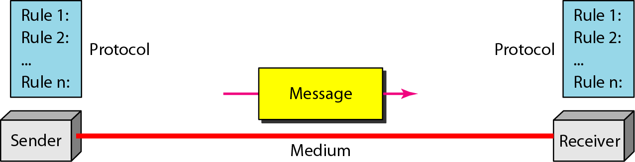
Topics discussed in this section:
Components
Data Representation Data Flow
Components
Figure 1.1 Five components of data communication
5
1
2
3
4

Slide 4
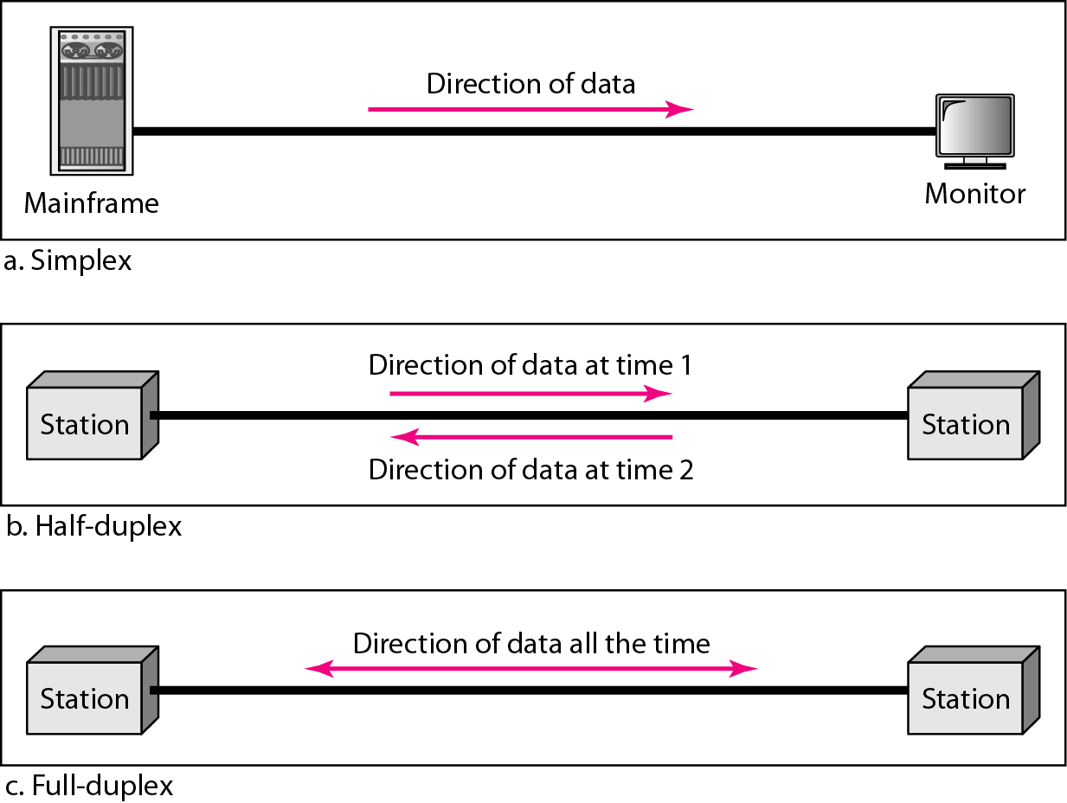
Data Representation
Text
Numbers
Images
Audio
Video
Data flow
Simplex
Half-duplex
Full-duplex

Slide 5
1-2 NETWORKS
A network is a set of devices (nodes) connected by communication links. A node can be a computer, printer, or any other device capable of sending and/or receiving data generated by other nodes on the network.
Topics discussed in this section:
Distributed Processing
Network Criteria (performance, reliability, and security) Physical Structures ( type of connections and topologies) Network Models
Categories of Networks ( LAN, MAN and WAN) Interconnection of Networks: Internet

Slide 6
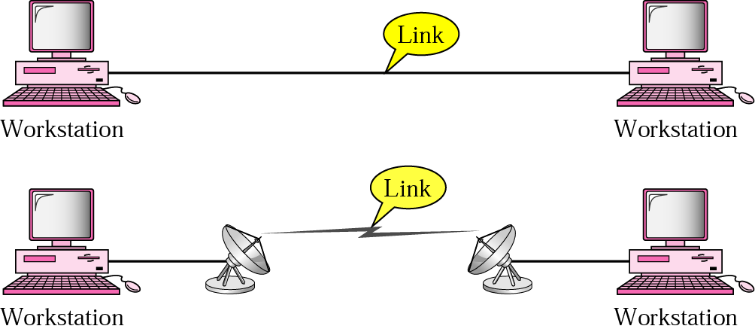
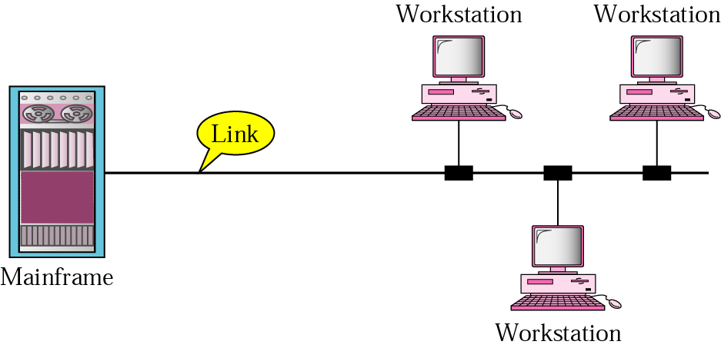
Types of connections
Point to point
A dedicated link is provided between two devices
Multipoint
More than two specific devices share a single link

Slide 7
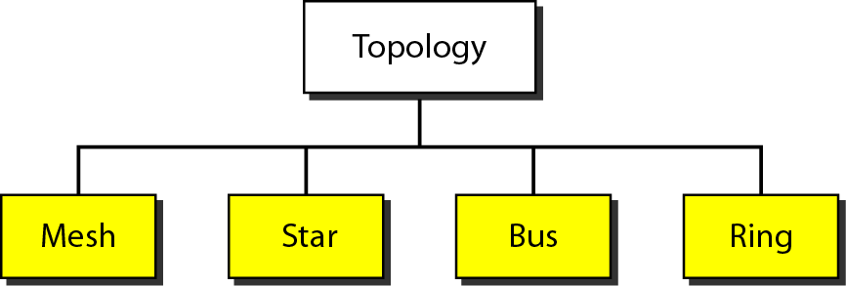
Physical Topology
Tree

Slide 8
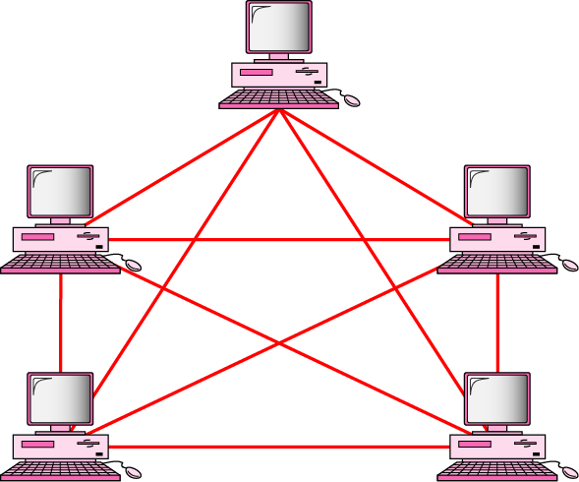
MESH Topology
Every device has a dedicated point-to-point link to every other devices
Dedicated
Link carries traffic only between the two devices it connects
A fully connected mesh network has n(n-1)/2 physical channels to link n devices
Every device on the network must have n-1 input/output (I/O) ports
Advantage
Less traffic, robust, secure, easy to maintain
Disadvantage
Need more resource (cable and ports), expensive
n(n-1)/2 physical duplex links

Slide 9
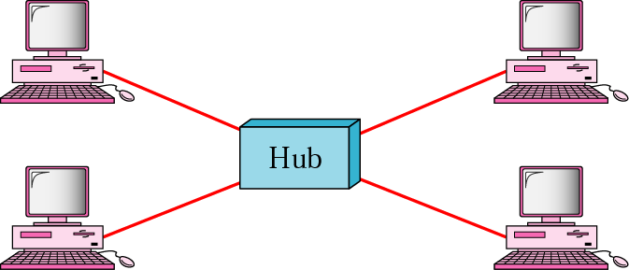
STAR Topology
Each device has a dedicated point-to-point link only to a central controller, usually called a hub.
No direct traffic and link between devices
Advantages
Less expensive
Easy to install and reconfigure
Robustness
Disadvantage
Single point of failure

Slide 10
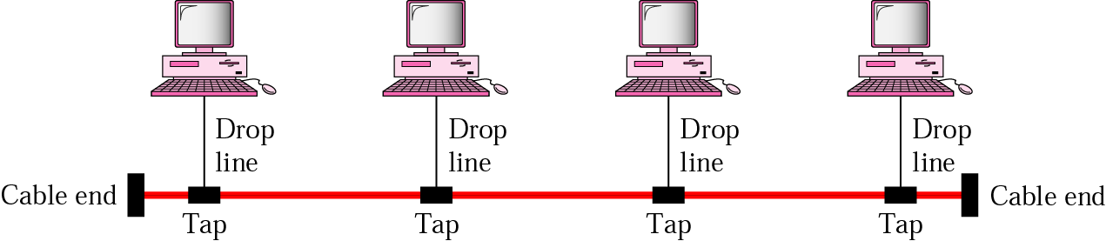
BUS Topology
A multipoint topology
All devices are linked through a backbone cable
Nodes are connected to the bus cable by drop lines and taps.
Drop line
A connection running between the device and the main cable
Tap
A connector that either splices into the main cable or punctures the sheathing of a cable to create a contact with the metallic core
Advantage:
Ease of installation
Disadvantages:
Difficult reconnection and fault isolation
Broken or fault of the bus cable stops all transmission

Slide 11
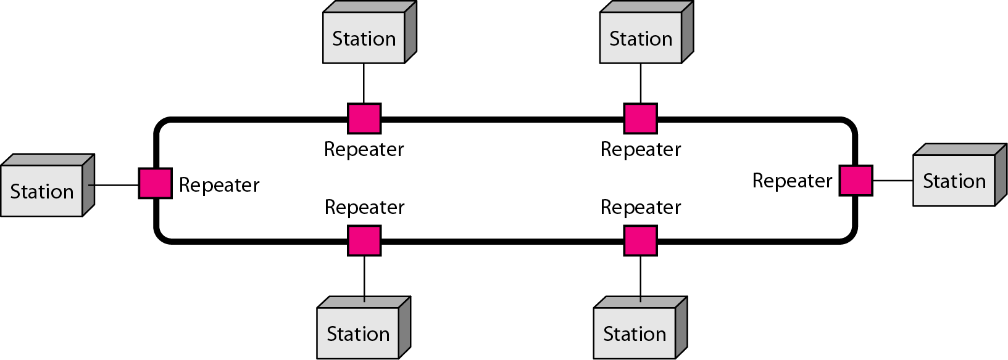
RING Topology
Each device is dedicated point-to-point connection only with the two devices on either side of it
A signal is passed along the ring in the direction, from device to device, until it reaches its destination
Each device in the ring incorporates a repeater
Advantages
Relatively easy to install and reconfigure
Fault isolation is simplified
Disadvantage
Unidirectional traffic

Slide 12
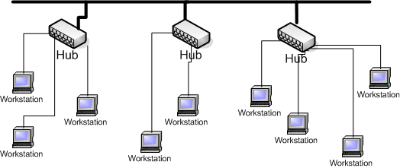
Tree Topology
Tree topologies integrate multiple topologies together
Example: Tree topology integrates multiple star topologies together onto a bus
Advantages:
Point-to-point wiring for individual segments.
Supported by several hardware and software venders.
Disadvantages:
Overall length of each segment is limited by the type of cabling used.
If the backbone line breaks, the entire segment goes down.
More difficult to configure and wire than other topologies.

Slide 13
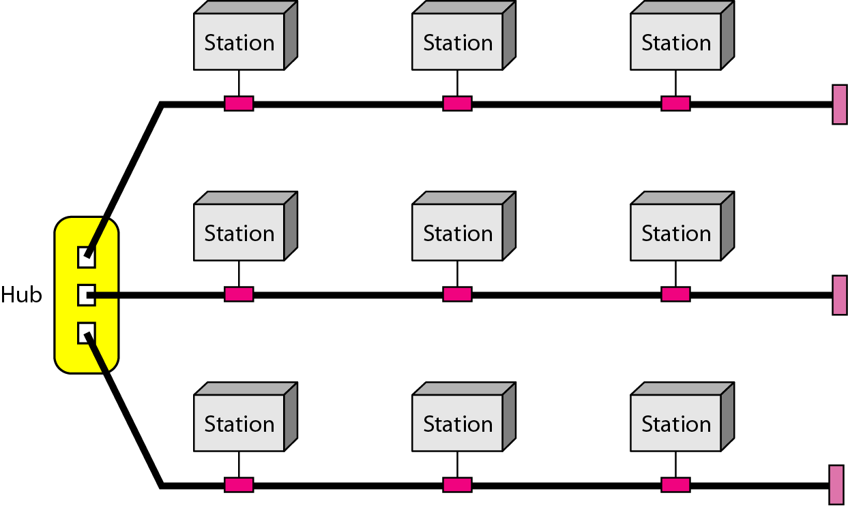
A hybrid topology: a star backbone with three bus networks

Slide 14
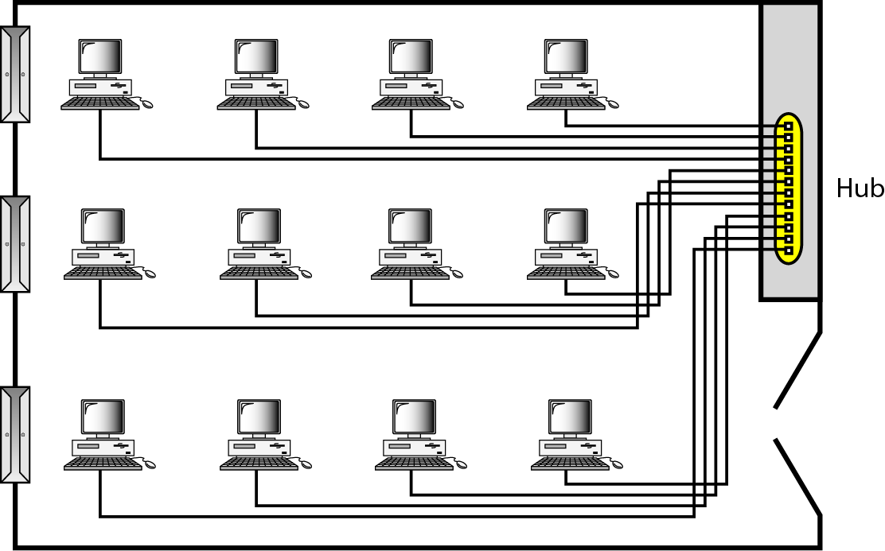
Categories of Networks
Local Area Network (LAN)
Wireless Local Area Network (WLAN)
Metropolitan Area Network (MAN)
Wide Area Network (WAN)
An isolated LAN connecting 12 computers to a hub in a closet

Slide 15
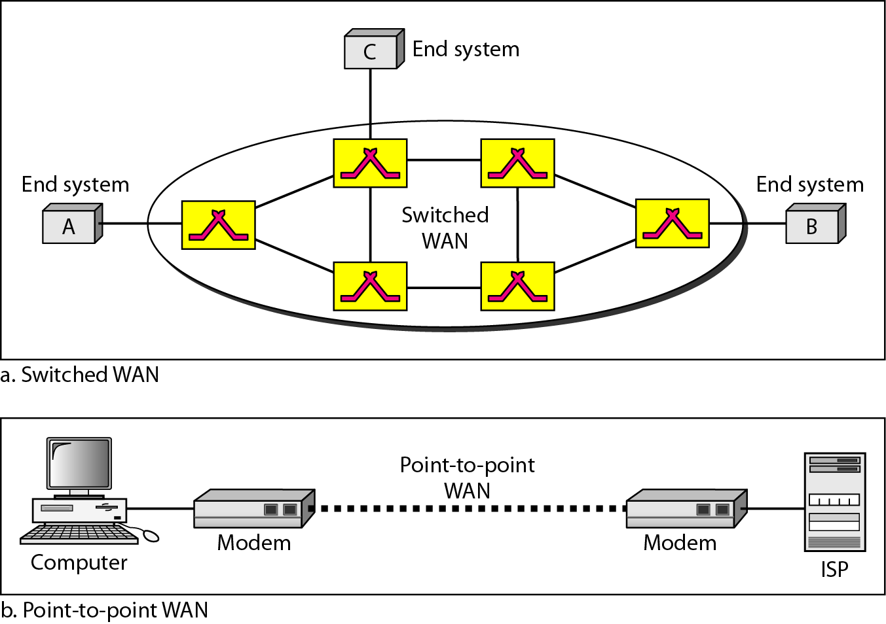
WANs: a switched WAN and a point-to-point WAN

Slide 16
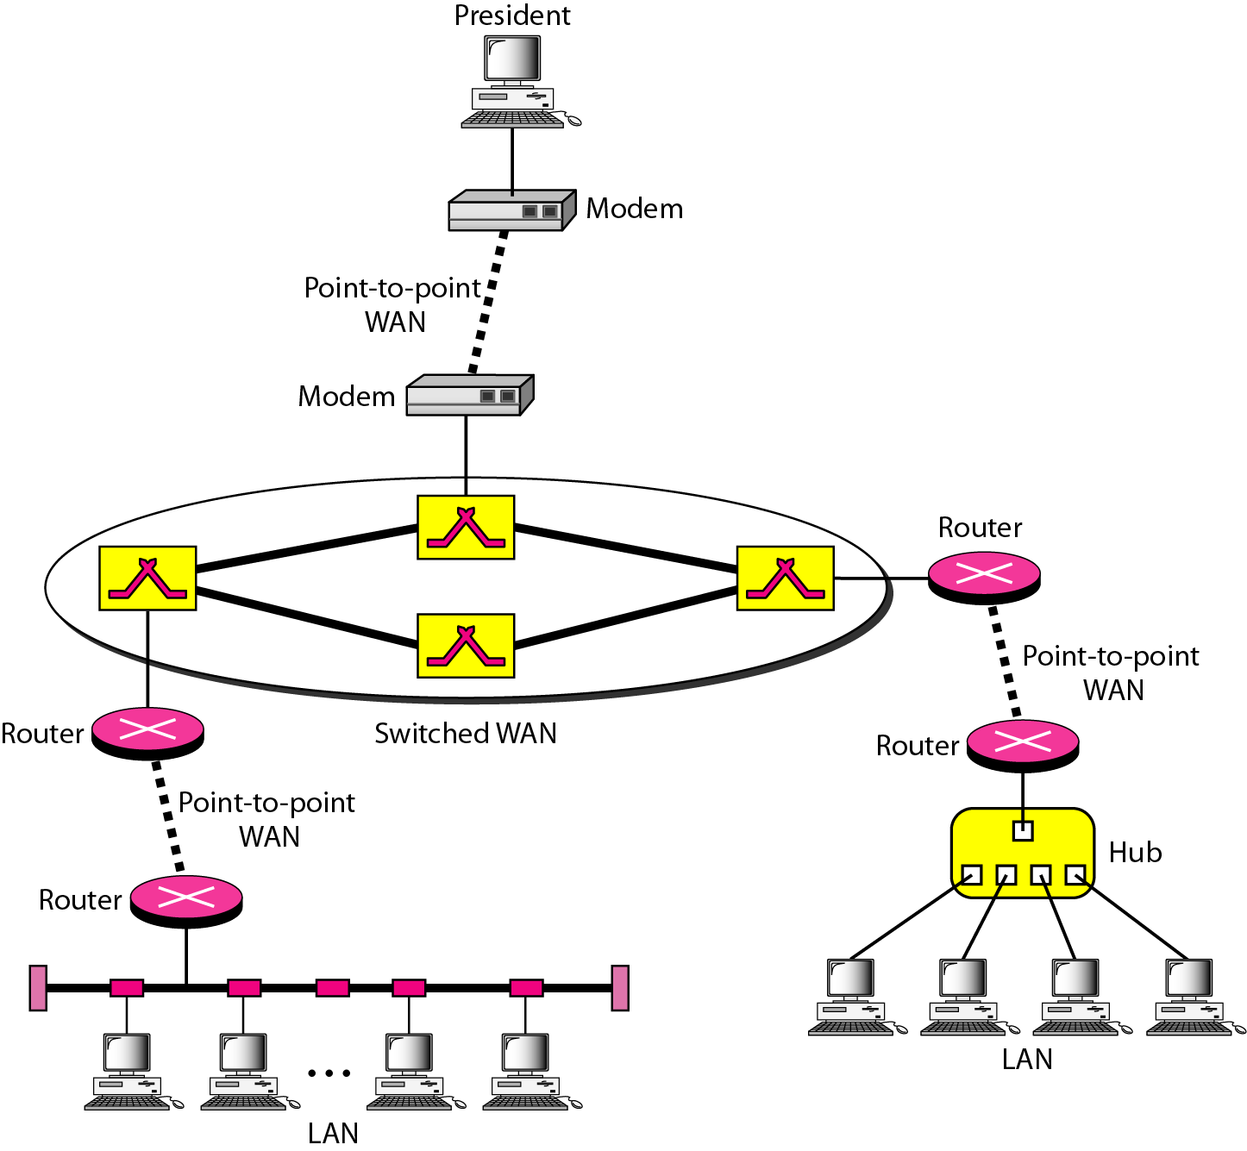
Interconnection of Networks: internet
A heterogeneous network made of four WANs and two LANs

Slide 17
1-3 THE INTERNET
The Internet has changed many aspects of our daily lives. It has affected the way we do business as well as the way we spend our leisure time. The Internet is a communication system that has brought a wealth of information to our fingertips and organized it for our use.
Topics discussed in this section:
A Brief History → ARPANET
1967 ACM
1969 UCLA, UCSB, SRI, UoU
1972 TCP
The Internet Today (ISPs)

Slide 18
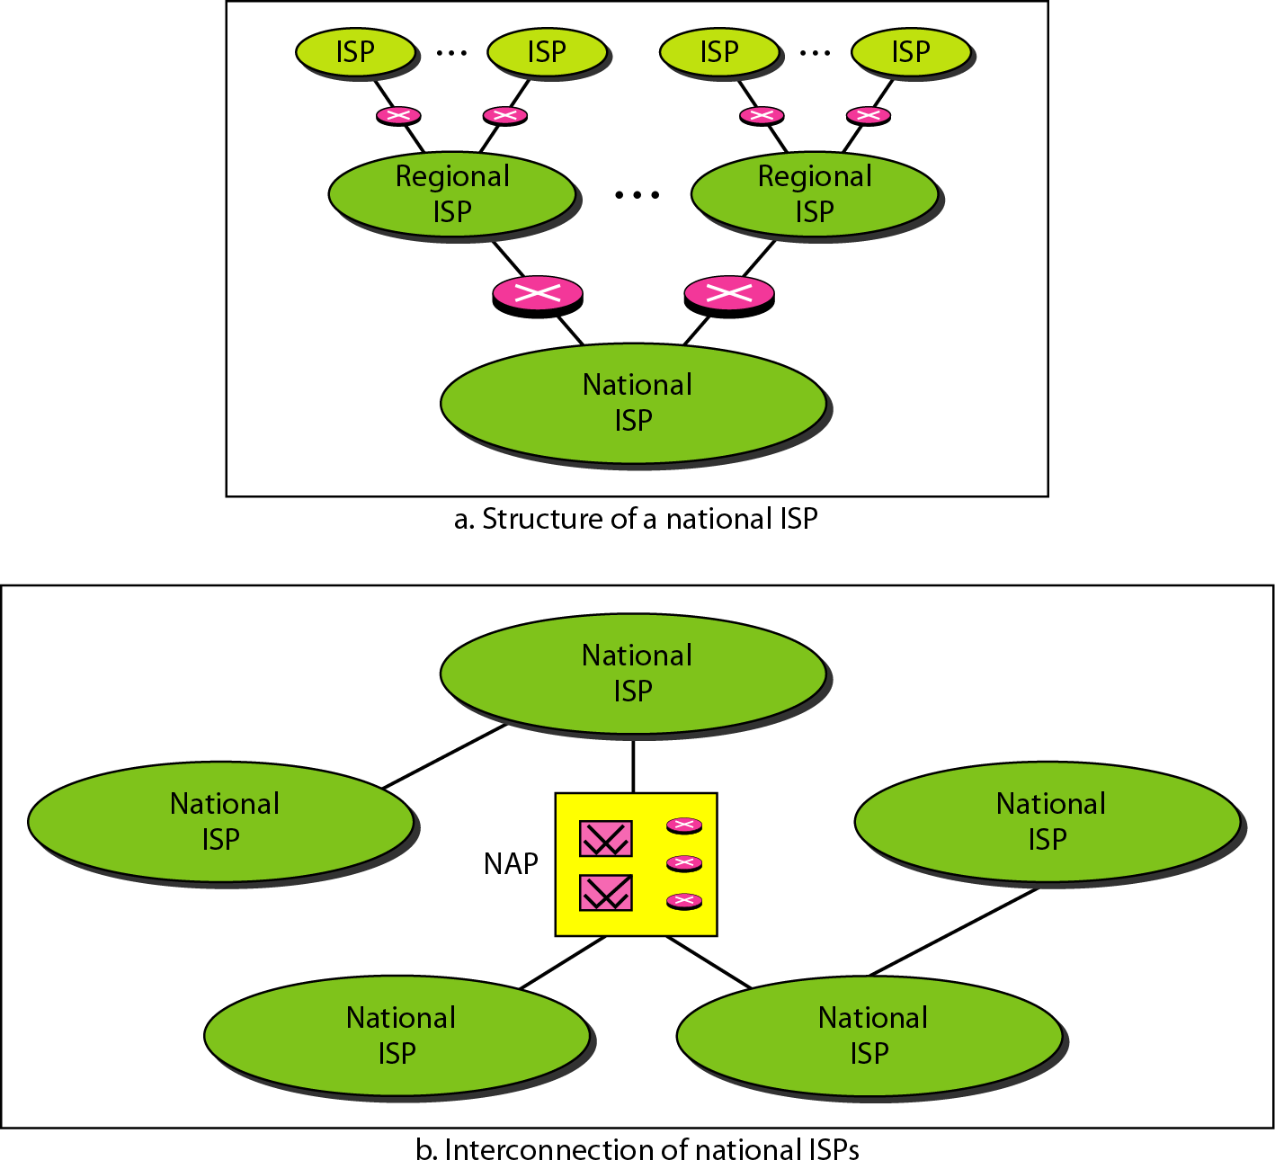
Hierarchical organization of the Internet

Slide 19
1-4 PROTOCOLS AND STANDARDS
protocols and standards.
Protocol is synonymous with rule.
Standards are agreed-upon rules.
Topics discussed in this section:
Protocols Standards
Standards Organizations
Internet Standards

Slide 20
PROTOCOLS AND STANDARDS
Protocols
Syntax → format of the data
Semantics → meaning of each section
Timing → when data should be sent and how fast.
Standards
De facto → by fact (not approved as a standard)
De jure → by Law (approved)

Slide 21
PROTOCOLS AND STANDARDS
Standards Organizations
International Organization for Standardization (ISO)
International Telecommunication Union - Telecommunication Standards (ITU-T)
American National Standards Institute (ANSI)
Institute of Electrical and Electronics Engineers (IEEE)
Electronic Industries Association (EIA)

Slide 22
Network Models
Lecture 2
OSI Model

Slide 23
1-5 LAYERED TASKS
A network model is a layered architecture
Task broken into subtasks
Implemented separately in layers in stack
Functions need in both systems
Peer layers communicate
Protocol:
A set of rules that governs data communication
It represents an agreement between the communicating devices

Slide 24
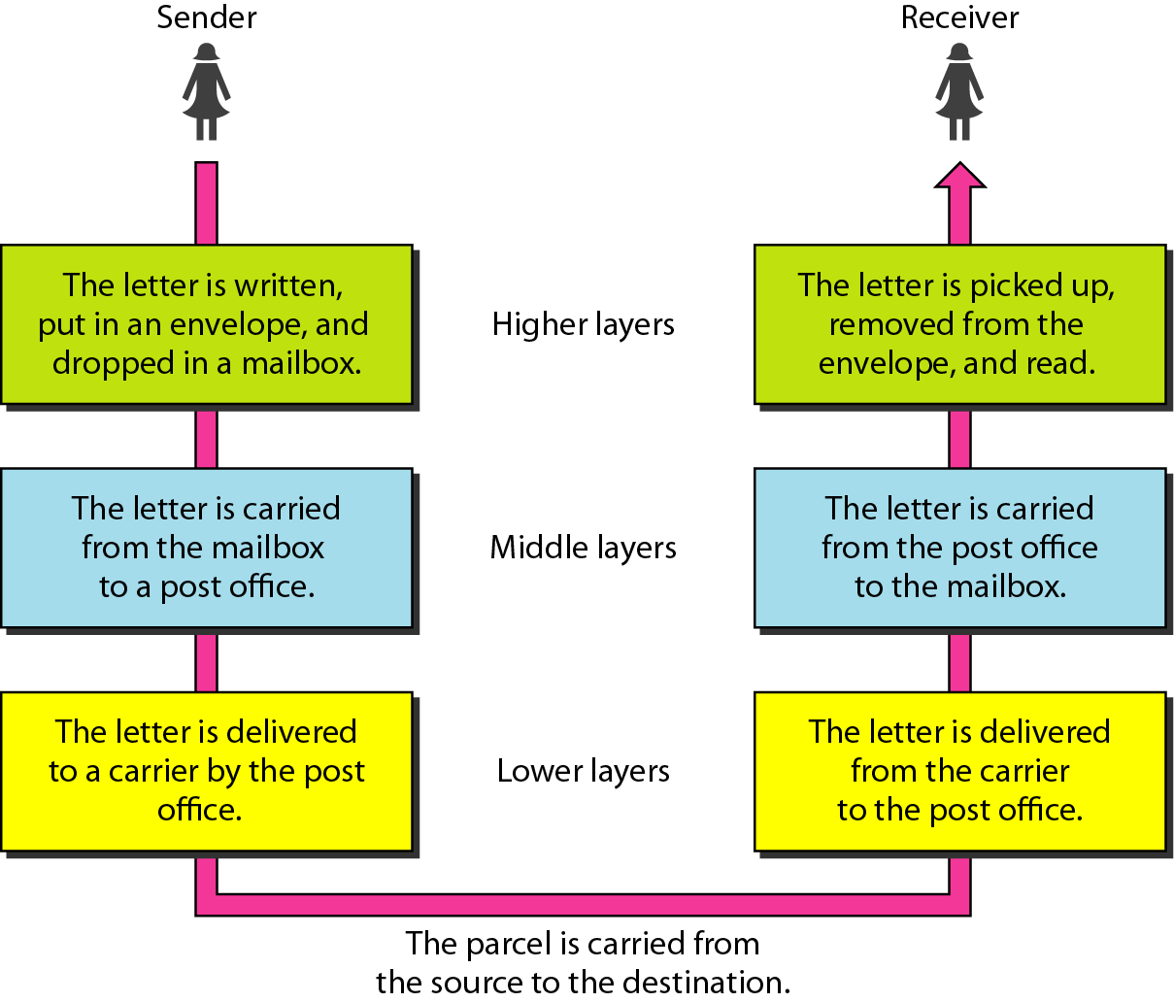
Tasks involved in sending a letter
Topics discussed in this section:
Sender, Receiver, and Carrier Hierarchy (services)

Slide 25
1-5.1 THE OSI MODEL
Established in 1947, the International Standards Organization (ISO) is a multinational body dedicated to worldwide agreement on international standards.
An ISO is the Open Systems Interconnection (OSI) model is the standard that covers all aspects of network communications from ISO. It was first introduced in the late 1970s.

Slide 26
ISO is the organization. OSI is the model.
Topics discussed in this section:
Layered Architecture Peer-to-Peer Processes
Encapsulation

Slide 27
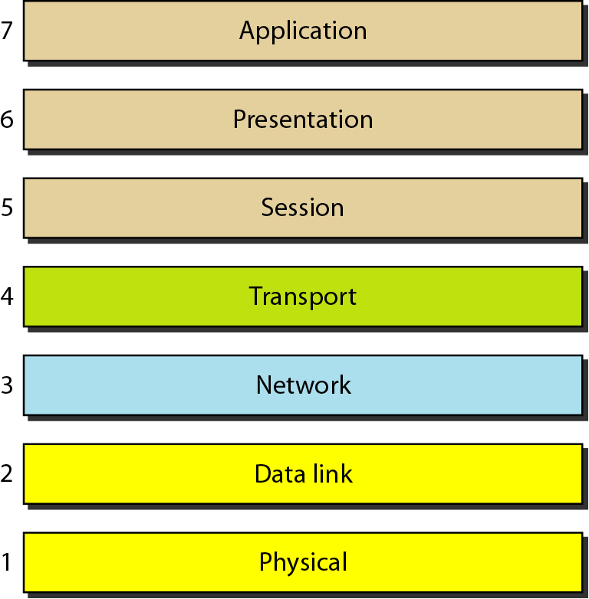
Layered Architecture
Layers
Layer 7. Application
Layer 6. Presentation
Layer 5. Session
Layer 4. Transport
Layer 3. Network
Layer 2. Data Link
Layer 1. Physical
Seven layers of the OSI model
Sender
Receiver

Slide 28
Layered Architecture
A layered model
Each layer performs a subset of the required communication functions
Each layer relies on the next lower layer to perform more primitive functions
Each layer provides services to the next higher layer
Changes in one layer should not require changes in other layers
The processes on each machine at a given layer are called peer-to-peer process

Slide 29
PEER – TO – PEER PROCESS
Communication must move downward through the layers on the sending device, over the communication channel, and upward to the receiving device
Each layer in the sending device adds its own information to the message it receives from the layer just above it and passes the whole package to the layer just below it
At the receiving device, the message is unwrapped layer by layer, with each process receiving and removing the data meant for it

Slide 30
PEER – TO – PEER PROCESS
The passing of the data and network information down through the layers of the sending device and backup through the layers of the receiving device is made possible by interface between each pair of adjacent layers
Interface defines what information and services a layer must provide for the layer above it.

Slide 31
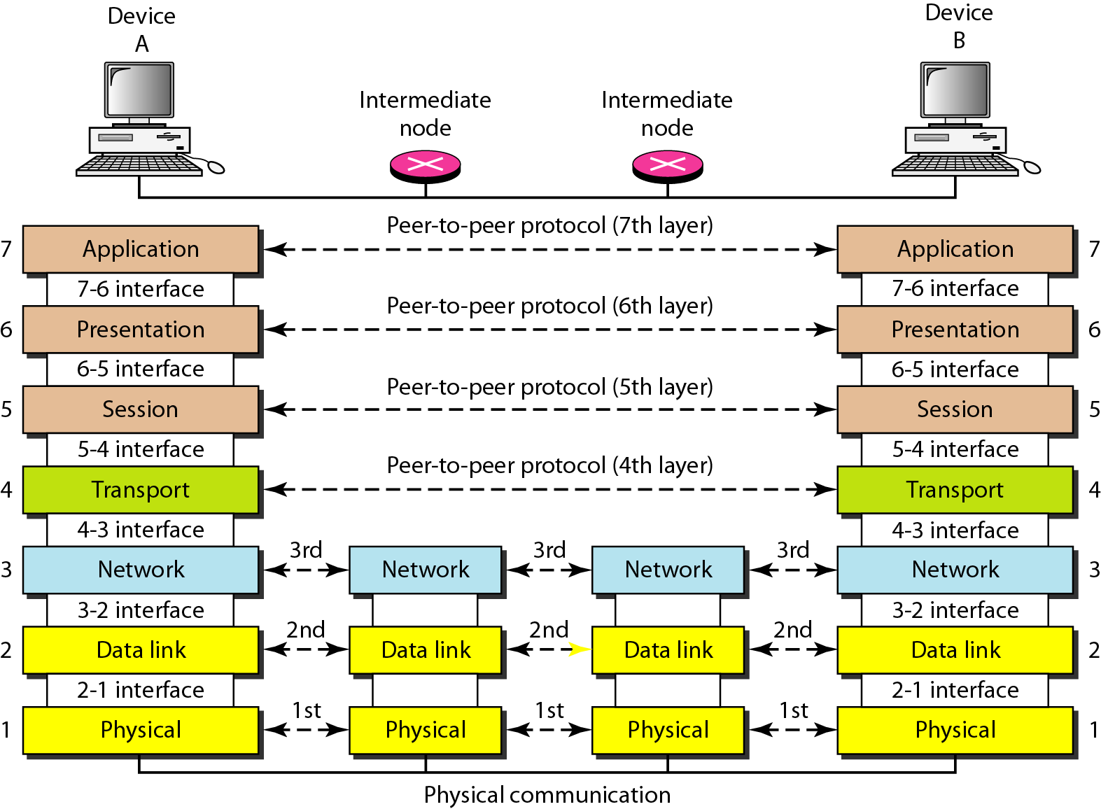
The interaction between layers in the OSI model

Slide 32
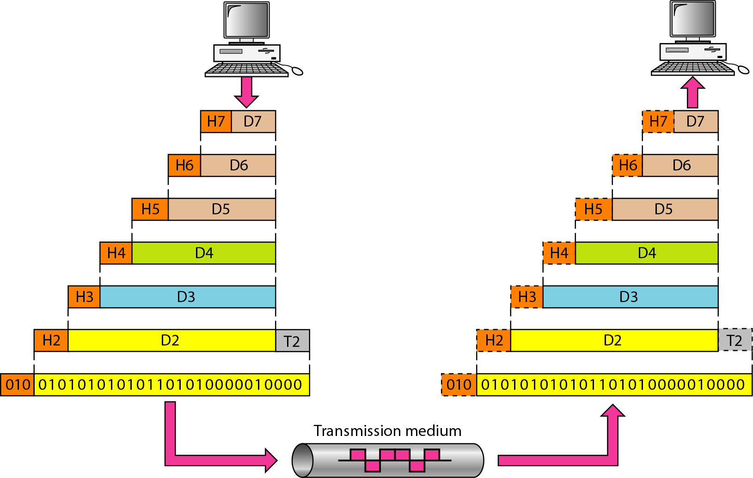
An exchange using the OSI model

Slide 33
LAYERS IN THE OSI MODEL
Topics discussed in this section:
Physical Layer
Data Link Layer
Network Layer
Transport Layer
Session Layer
Presentation Layer
Application Layer

Slide 34
Physical Layer
The physical layer is responsible for movements of
individual bits from one hop (node) to the next.
Function
Physical characteristics of interfaces and media
Representation of bits
Data rate
Synchronization of bits
Line configuration (point-to-point or multipoint)
Physical topology (mesh, star, ring or bus)
Transmission mode ( simplex, half-duplex or duplex)

Slide 35
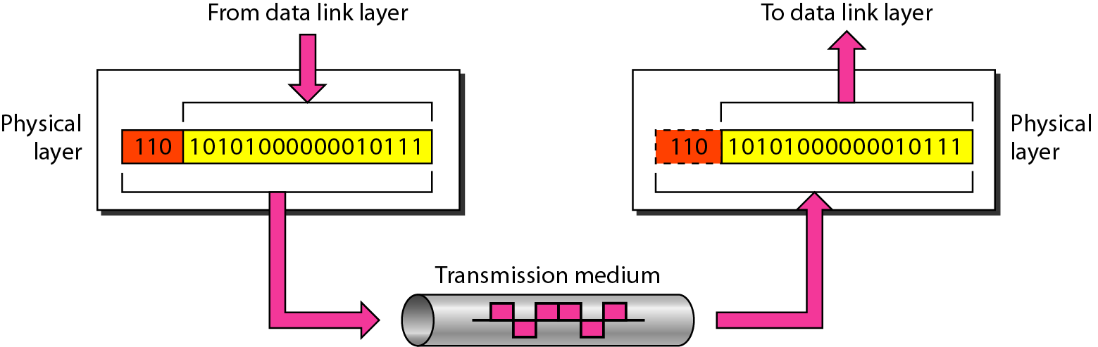
Physical layer

Slide 36
Data Link Layer
The data link layer is responsible for moving frames from one hop (node) to the next.
Function
Framing
Physical addressing
Flow control
Error control
Access control

Slide 37
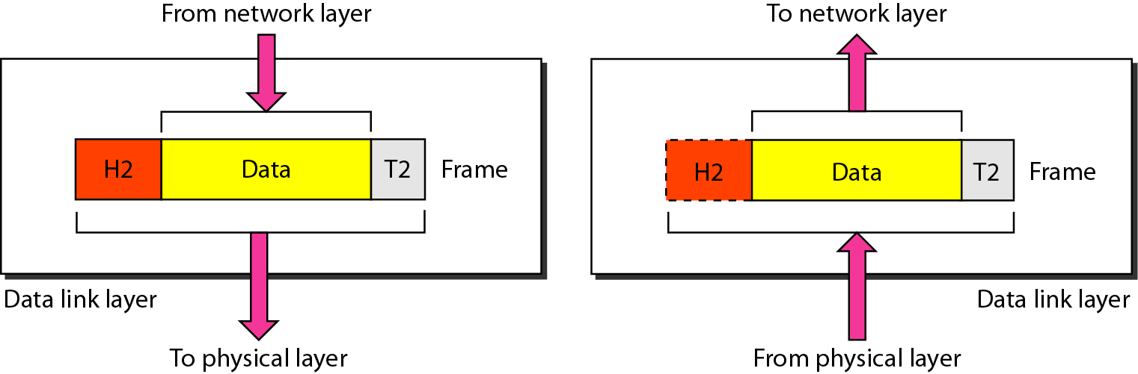
Data link layer

Slide 38
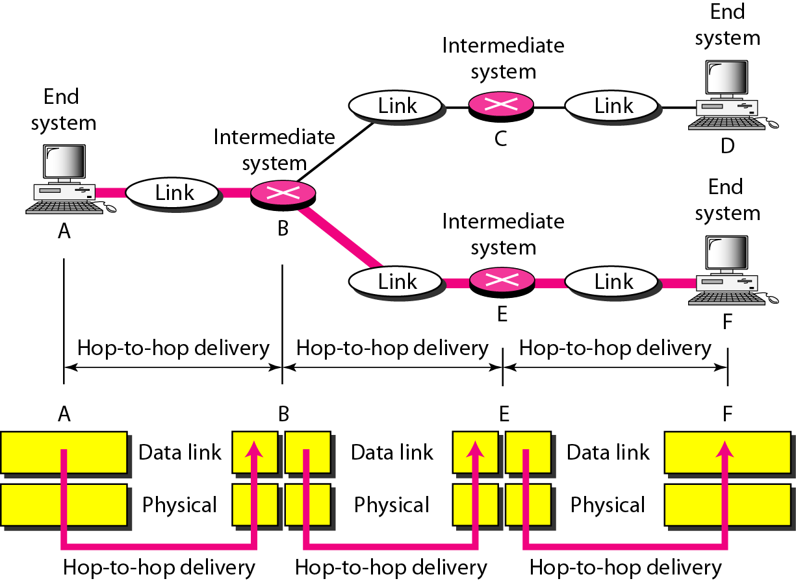
Hop-to-hop delivery

Slide 39
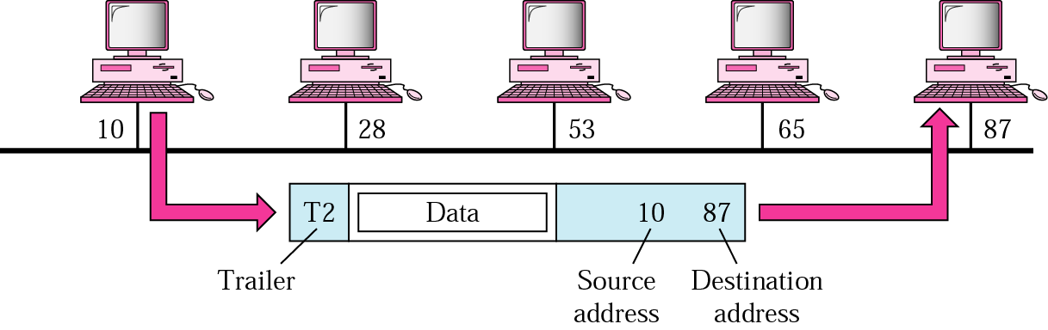
Example 1
In following Figure a node with physical address 10 sends a frame to a node with physical address 87. The two nodes are connected by a link. At the data link level this frame contains physical addresses in the header. These are the only addresses needed. The rest of the header contains other information needed at this level. The trailer usually contains extra bits needed for error detection

Slide 40
Network Layer
The network layer is responsible for the delivery of individual packets from
the source host to the destination host.
Source-to-destination delivery
Responsible from the delivery of packets from the original source to the final destination
Functions
Logical addressing
routing

Slide 41
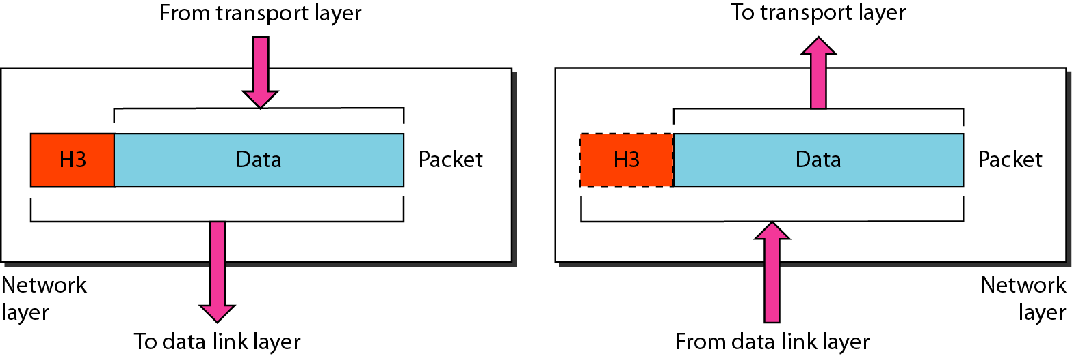
Network layer

Slide 42
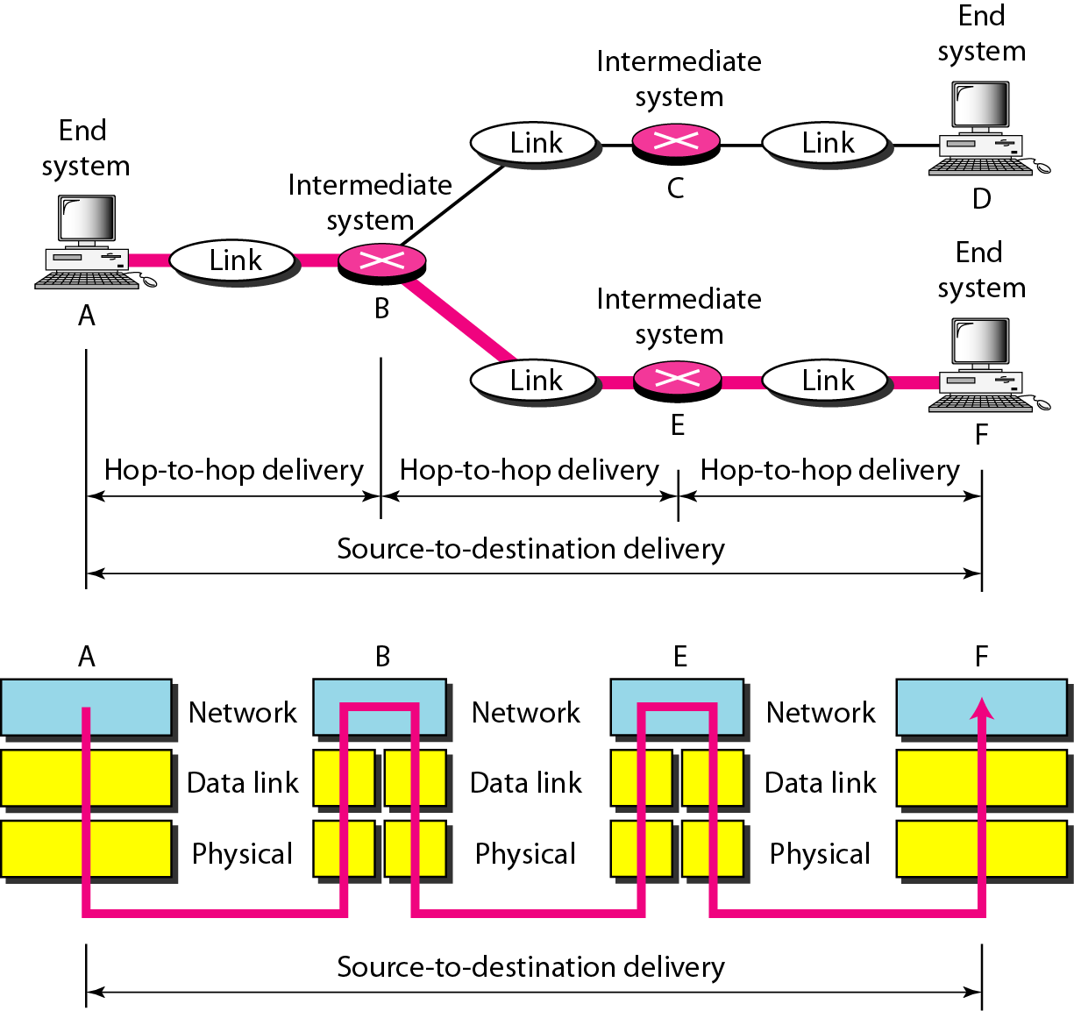
Source-to-destination delivery

Slide 43
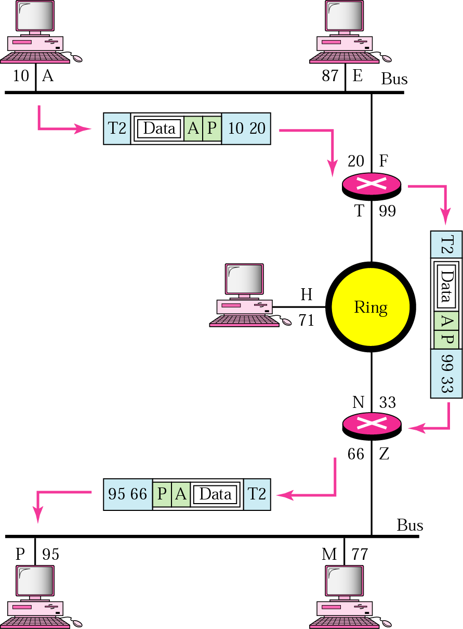
Example 2
We want to send data from a node with network address A and physical address 10, located on one LAN, to a node with a network address P and physical address 95, located on another LAN. Because the two devices are located on different networks, we cannot use physical addresses only; the physical addresses only have local influence. What we need here are universal addresses that can pass through the LAN boundaries. The network (logical) addresses have this characteristic.

Slide 44
Transport Layer
The transport layer is responsible for the delivery of a message from one process to another.
Process-to- process delivery
Functions
Port addressing
Segmentation and reassembly
Connection control ( Connection-oriented or connection-less)
Flow control
Error control

Slide 45
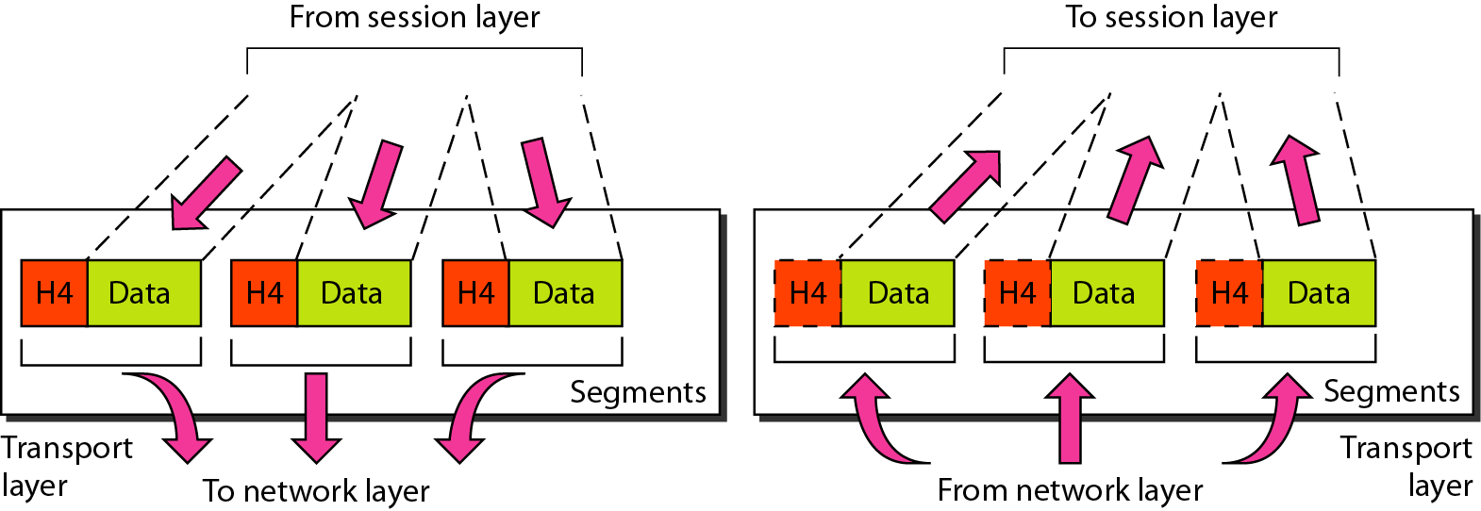
Transport layer
Segmentation and reassembly

Slide 46
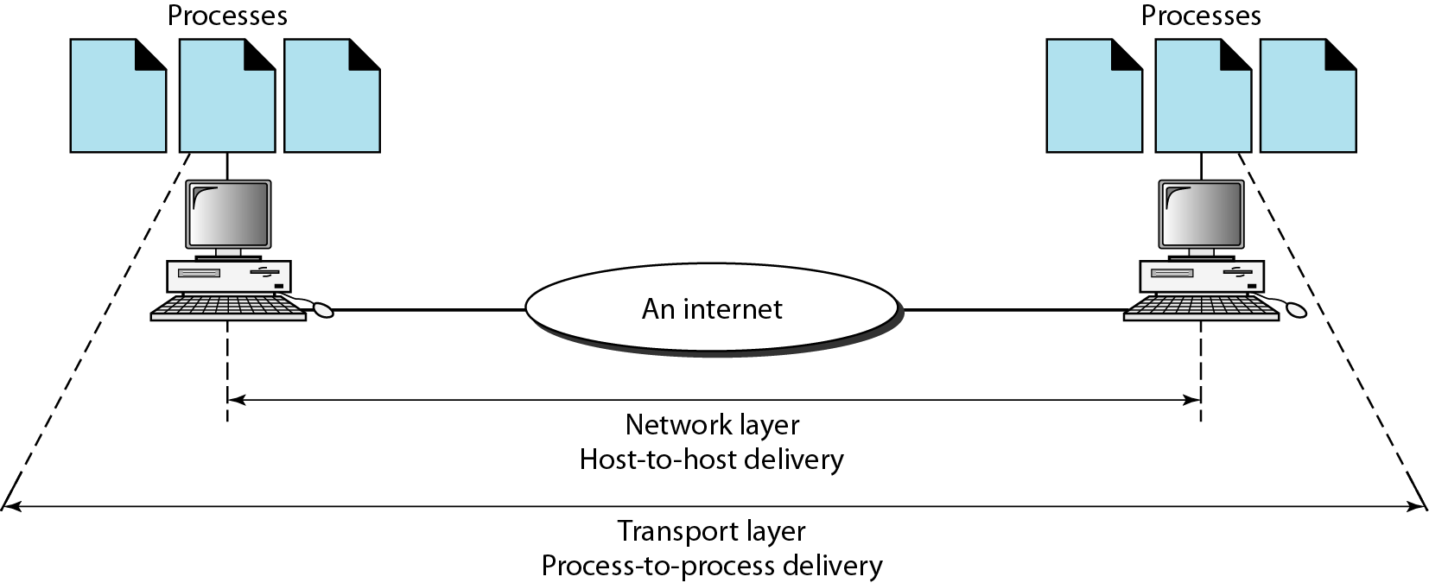
Reliable process-to-process delivery of a message

Slide 47
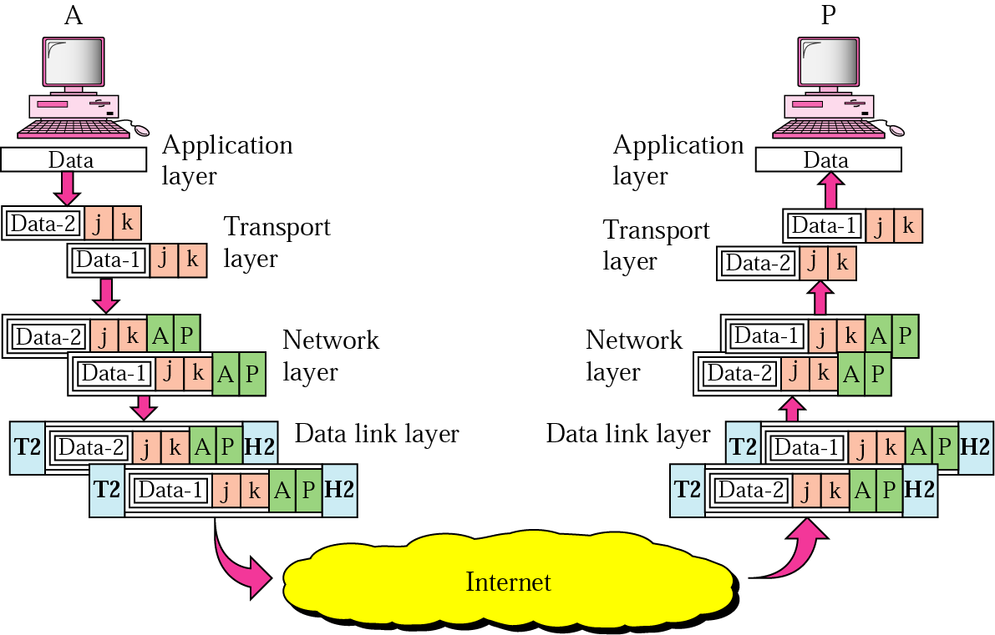
Example 3
Data coming from the upper layers have port addresses j and k (j is the address of the sending process, and k is the address of the receiving process). Since the data size is larger than the network layer can handle, the data are split into two packets, each packet retaining the port addresses (j and k). Then in the network layer, network addresses (A and P) are added to each packet.

Slide 48
Session Layer
The session layer is responsible for dialog control and synchronization.
It establishes, maintains and synchronize the interaction between communicating system
Function
Dialog control
Synchronization (checkpoints)

Slide 49
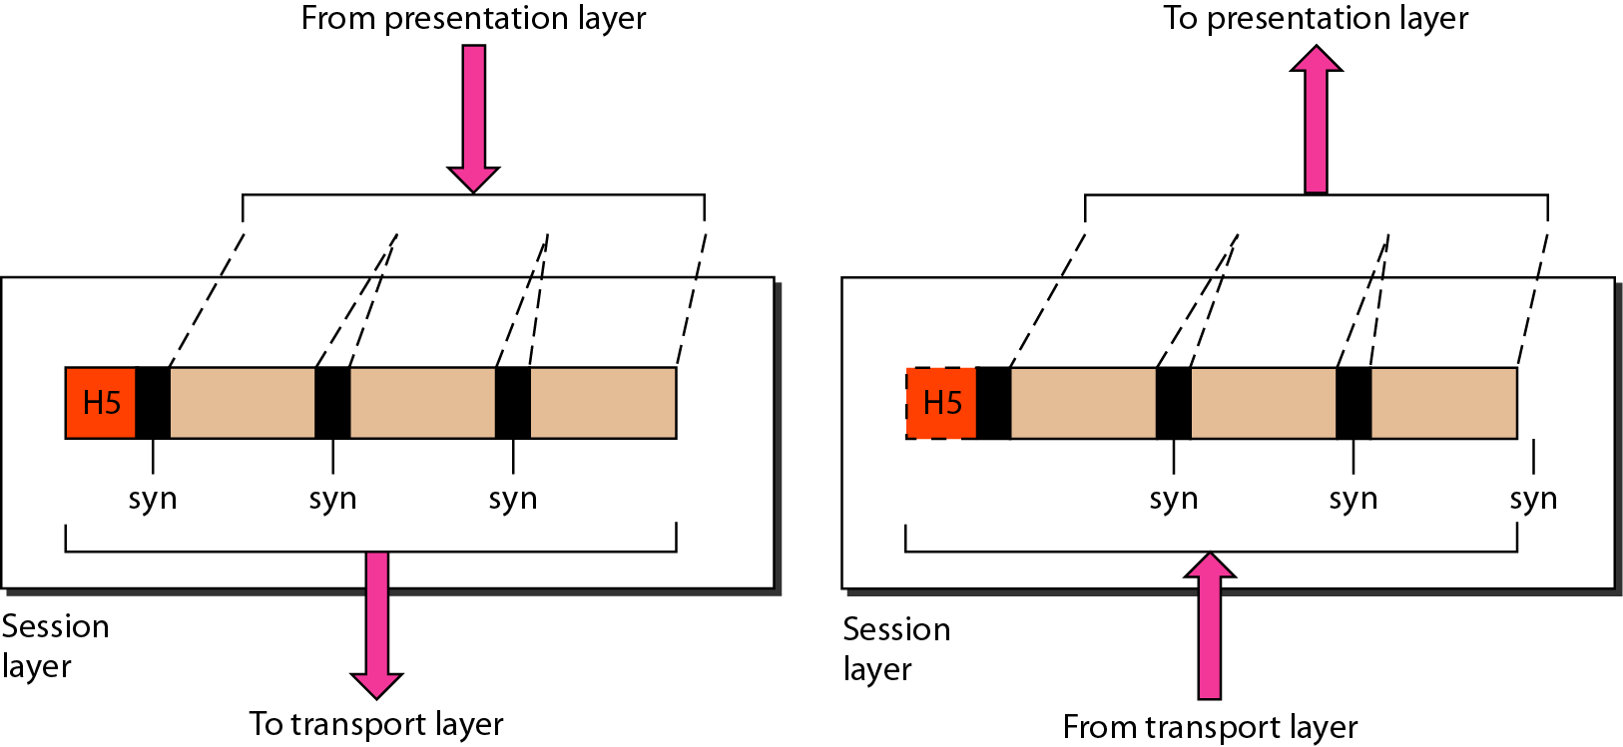
Session layer
Synchronization

Slide 50
Presentation Layer
The presentation layer is responsible for translation, compression, and encryption.
Concerned with the syntax and semantics of the information exchanged between two system
Functions
Translation ( EBCDIC-coded text file → ASCII-coded file)
Encryption and Decryption
Compression

Slide 51
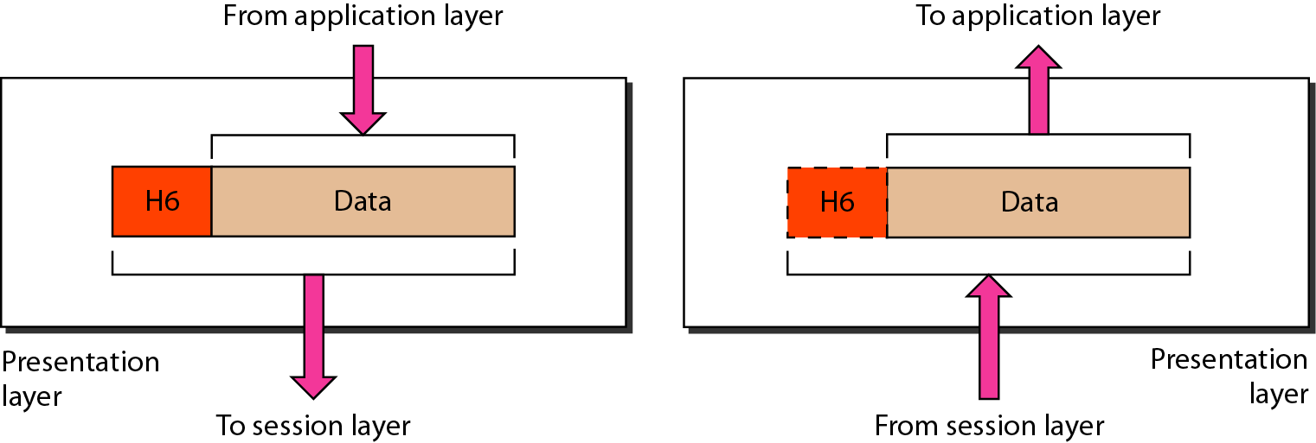
Presentation layer

Slide 52
Application Layer
The application layer is responsible for providing services to the user.
Functions
Network virtual terminal (Remote log-in)
File transfer and access
Mail services
Directory services (Distributed Database)
Accessing the World Wide Web

Slide 53
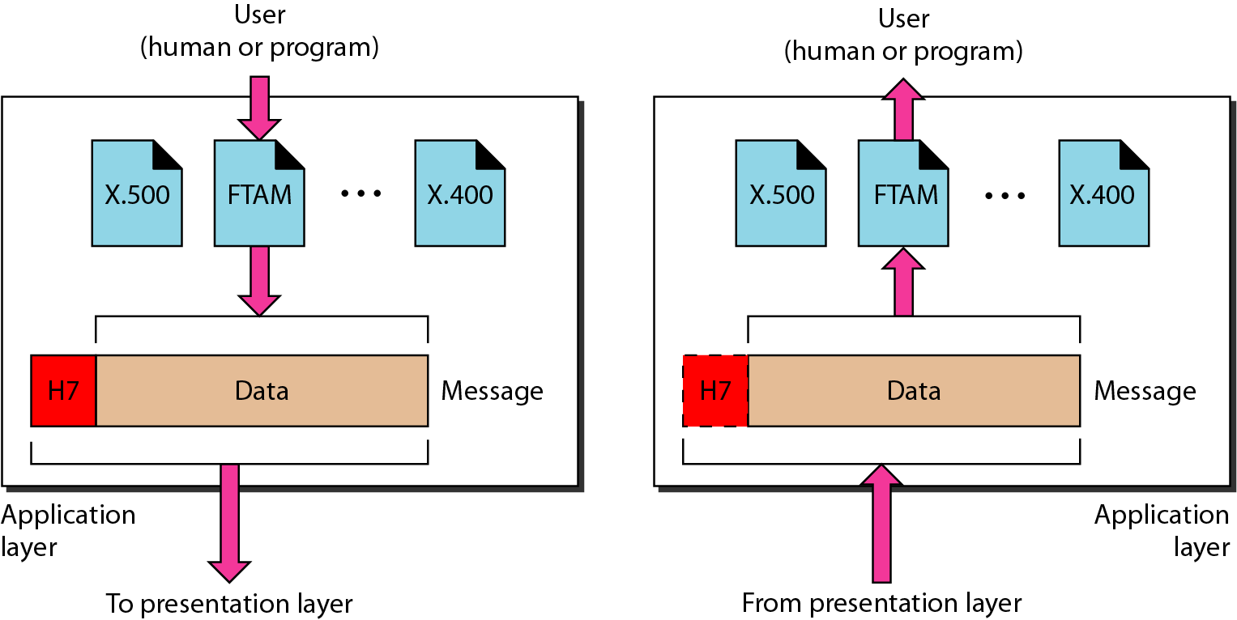
Application layer

Slide 54
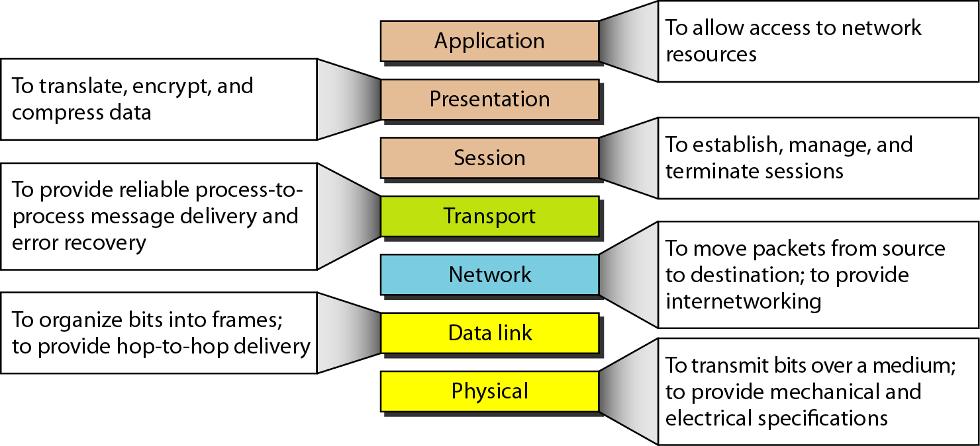
Summary of layers

Slide 55
Summary of layers
OSI Model
 | Data unit | Layer | Function
User support layers | Data | 7. Application | Network process to application
 |  | 6. Presentation | Data representation and encryption
 |  | 5. Session | Inter-host communication
User⬄ Network | Segment | 4. Transport | End-to-end connections and reliability
Network support layers | Packet | 3. Network | Path determination and logical addressing
 | Frame | 2. Data Link | Physical addressing
 | Bit | 1. Physical | Media, signal and binary transmission
Sender
Receiver

Slide 56
Network Models
Lecture 3
TCP/IP Model

Slide 57
1-5.2 TCP/IP PROTOCOL SUITE
The layers in the TCP/IP protocol suite do not exactly match those in the OSI model. The original TCP/IP protocol suite was defined as having four layers: host-to-network, internet, transport, and application. However, when TCP/IP is compared to OSI, we can say that the TCP/IP protocol suite is made of five layers: physical, data link, network, transport, and application.
Topics discussed in this section:
Physical and Data Link Layers Network Layer Transport Layer
Application Layer

Slide 58
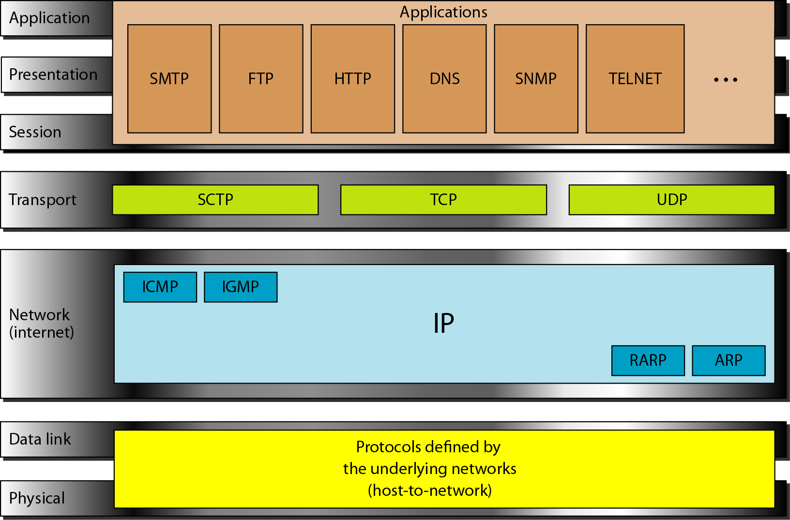
TCP/IP and OSI model
OSI Model
TCP/IP Model

Slide 59
Internet Layer
TCP/IP support the Internet Protocol IP ( unreliable).
IP is a host-to-host protocol.
Supporting protocols:
Address Resolution Protocol (ARP)
Reverse Address Resolution Protocol (RARP)
Internet Control Massage Protocol (ICMP)
Internet Group Massage Protocol (IGMP)

Slide 60
Transport Layer
Process-to-process protocol.
User Datagram Protocol (UDP)
Transmission Control Protocol (TCP)
Stream Control Transmission Protocol (SCTP)

Slide 61
1-6 ADDRESSING
Four levels of addresses are used in an internet employing the TCP/IP protocols: physical, logical, port, and specific.
Topics discussed in this section:
Physical Addresses Logical Addresses Port Addresses Specific Addresses

Slide 62
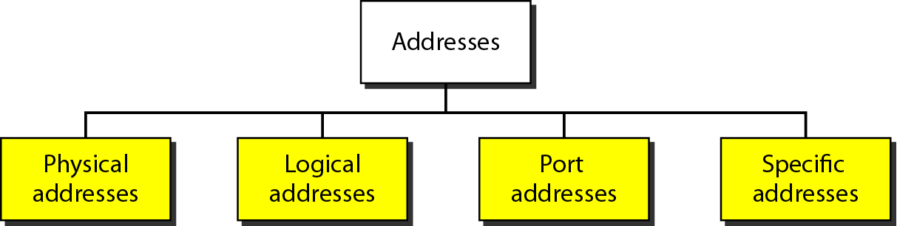
Addresses in TCP/IP

Slide 63
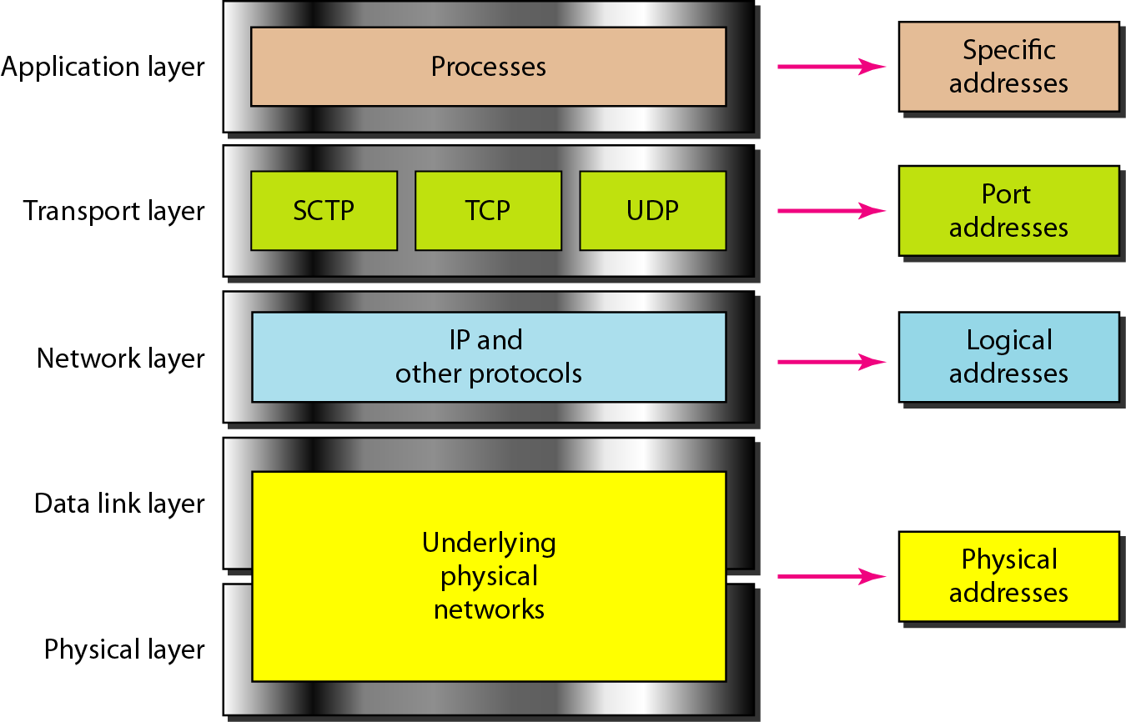
Relationship of layers and addresses in TCP/IP

Slide 64
Physical Address
Physical addresses are imprinted on the NIC. Most local-area networks (Ethernet) use a 48-bit (6-byte) physical address written as 12 hexadecimal digits; every byte (2 hexadecimal digits) is separated by a colon.
Example:
07:01:02:01:2C:4B A 6-byte (12 hexadecimal digits) physical address.

Slide 65
Physical Address
known also as the MAC address
Is the address of a node as defined by its LAN or WAN
It is included in the frame used by data link layer
The physical addresses in the datagram may change from hop to hop.

Slide 66
Logical Address
IP addresses are necessary for universal communications that are independent of physical network.
No two host address on the internet can have the same IP address
IP addresses in the Internet are 32-bit address that uniquely define a host.
The physical addresses will change from hop to hop,
but the logical addresses usually remain the same.

Slide 67
Port addresses
Port address is a 16-bit address represented by one decimal number ranged from (0-65535) to choose a process among multiple processes on the destination host.
Destination port number is needed for delivery.
Source port number is needed for receiving a reply as an acknowledgments.
In TCP/IP , a 16-bit port address represented as one single number. Example: 753
The physical addresses change from hop to hop,
but the logical and port addresses usually remain the same.

Slide 68
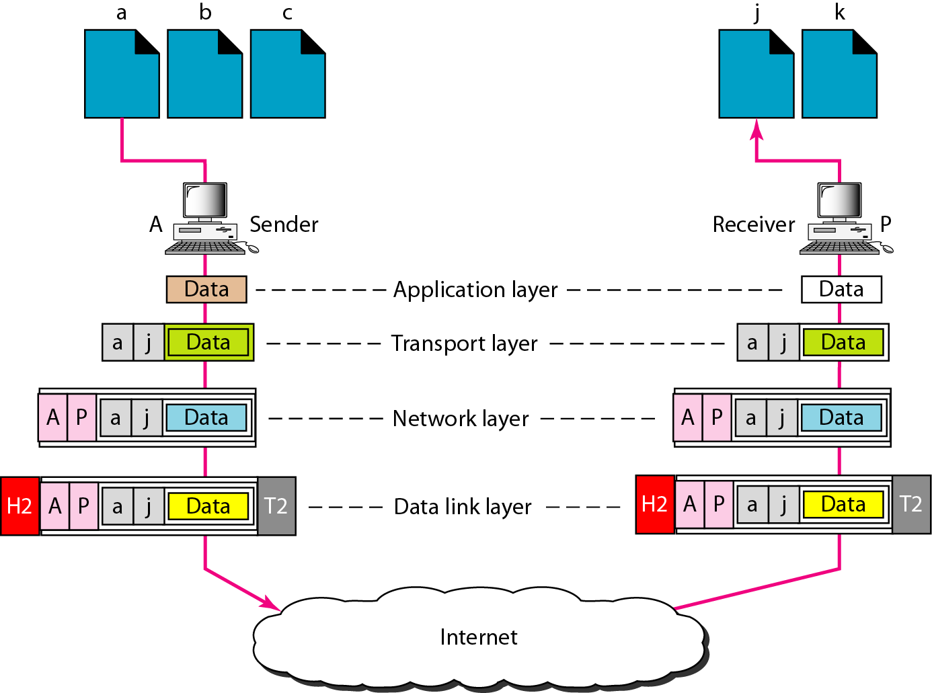
Port addresses

Slide 69
Specific addresses
E-mail address (user1@ksu.edu.sa)
Universal Resource Locator (URL) (www.ksu.edu.sa)
The Domain Name System (DNS) translates human-friendly computer hostnames ( URL) into IP addresses. For example, www.example.com is translated to 208.77.188.166

